Slide 1
Neuroteam
“Unlocking the potential of neurodivergent talent”
ILO GBDN
9th annual conference
November 28th, 2022
September 2022
Dr Mariana GUEZ

Slide 2
What is neurodiversity?
All the variations
in human cognition, including neurotypicals & neuroatypicals.
It’s just all of us!
=> Neurominorities = neuroatypicals = neurodivergents
estimated to represent 20% of world’s population
ASD (autism spectrum disorders)
“Dys” disorders (dyscalculia, dyspraxia, dysorthographia, …)
ADHD (attention deficit/hyperactivity disorder)
HIP (high intellectual potential)
…
Different ways of learning and using information based on a physical, neurological condition.

Slide 3
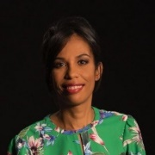
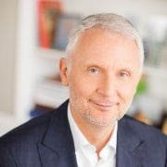
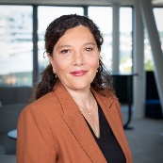
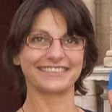
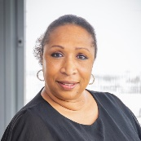
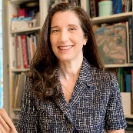
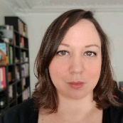
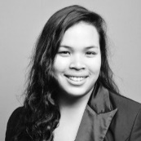
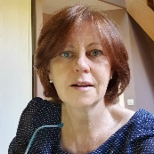
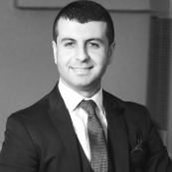
Neuroteam’s Governance
Executive committee sponsors
Elizabeth Tchoungui
Group Executive Director CSR, Diversity and Philanthropy
Gervais
Pellissier
Deputy CEO, People & Transformation, Chairman of OBS
Delphine Pouponneau
Program Leader
Steering committee and permanent coordinators
Expert resources
Occupational health & safety
Quality of Life at Work
Sourcing and external recruitment
Corinne Bastid
Coordination
of work by
inclusion project teams
Valérie Tiacoh
Devising and coordinating international development
Dr. Mariana Guez
Occupational health and safety contact, expert approval of content
Talent Management
Purchasing
Mélodie Ardouin Identifying POCs and testing, including the group “Les Z’Atypiques”
Emmanuelle Campo
Equal opportunities team
Véronique Boularand & Malek Merabti
Disability Support Group and HR contacts, recruitment assistance and support
Link with Orange Foundation
(“Volontaires pour l’Autisme” Association since 1992)
Notes:
Apporter de la valeur ajoutée à des projets existants (POC)

Slide 4
Neuroteam’s ambitions
Facilitate collaboration amongst teams
Limit bias and stereotypes
Open up to new talent as soon as we recruit
Enrich development and innovation approaches

Slide 5
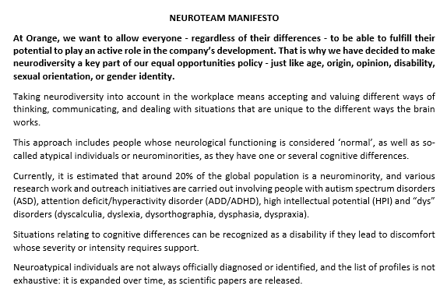
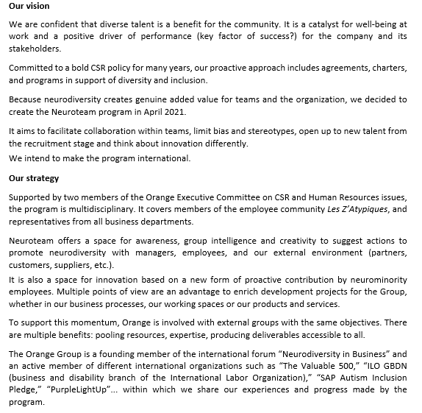
Neuroteam manifesto

Slide 6
Neuroteam in action at Orange
First achievements
Awareness and training
Conference Dr Nancy Doyle (internal & external stakeholders)
Specialized interventions for occupational doctors, social workers, worker representatives
For all group employees: a “mini-guide”, a glossary, 12 learning modules
Communication kit for the comm departments, the diversity correspondents & the H&S managers
Managers: inclusive management self-assessment
Recruitment
Selection of a specialized recruitment firm to support recruiting managers
Inclusive recruitment training to teams in charge of recruitment campaigns for more than 2,000 trainees / year
Experiments Participation of neuroatypical employees in reflections on the development or improvement of tools, processes and work environments
And for 2023…
Harmonization of internal communication media and recommendations of guidelines to the Brand and Accessibility Departments
Production of an expert reference guide for our entire ecosystem
Creation of a training playlist dedicated to the development of neuroatypical talents…
Orange collaborative risk assessment (completed)
2 proofs of concepts in progress: Inclusive work environment, Chatbot

Slide 7
What about external visibility?
Sharing at international level, producing deliverables and speeches during key events
or within coalitions
Neurodiversity In Business (NIB) – Founding member since launch (March 22, 2022)
Network of businesses committed to the inclusion of neurodiverse individuals in the workplace
European Commission: telecommunications social dialog committee – Active member
Participation in work by the DUFA (Digital Upskilling For All) group: promoting digital inclusion within diversity, notably neurodiversity (dedicated website)
Autism Inclusion Pledge (SAP) – Signatory member
Program including organizations committed to the inclusion of people with ASD in
the workplace
International Labor Organization - Global Business & Diversity Network – Active member
Speech at the webinar dedicated to neuroinclusive businesses April 19, 2022
The Valuable 500 – Active member
Participation in discussions
Identification of the Group as a committed employer to attract potential candidates:
School / University partnerships
Specialist associations

Slide 8
Thank you!

